Slide 1

COVID INFO
Presentation
Group 4
Supervised by: Mr. NGO PHUOC NGUYEN

Slide 2
Team members
No | Name | Student ID
1 | Nguyen Nhuan Phat | Student1235025
2 | Vo Duc Chinh | Student1233862
3 | Hoang Giang Chuan | Student1235028
4 | Dao Nguyen Xuan Huy | Student1233877

Slide 3
Table of Content
Introduction
Project Preview
Conclusion and disccusion
Task list

Slide 4

Introdution
Introduction
During the complicated situation of the ongoing pandemic COVID-19, the increasing need to access to COVID-19 information as well as manage COVID-19 related patients is the reason why we are developing a system for the government to manage patients as well as providing COVID-19 information to the people.

Slide 5
Introduction
Problem definition
Covid info is a system where:
User can look up Covid-19 case numbers, Covid-19 articles as well as registering themselves for health declaration and travel history through an Android application.
Medical Staffs can manage users attributes such as PCR test, health declarations, travel histories and can perform quarantine or treatment admission a user.

Slide 6
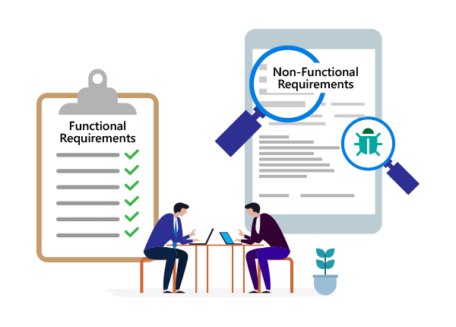
Introduction
Requirement of the project
To achieve the above objective, our system need these core features:
Functional feature:
User managing
Medical staff managing
Calling Covid number API
Calling Covid articles API
User quarantine process
User treatment admission process
User discharge process
PCR tests managing
Health declarations managing
Travel histories managing
Etc…

Slide 7
Introduction
Requirement of the project
To achieve the above objective, our system need these core features:
Non-functional feature
Phone OTP
Infected area map
User chart
F1 and F0 user QR code
F1 and F0 user report
Multi language

Slide 8
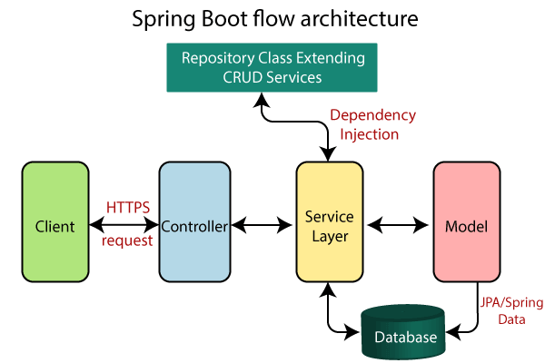
Introduction
Deployment diagram
Backend: Spring boot API
User frontend: Android App
Admin frontend: Reactjs

Slide 9

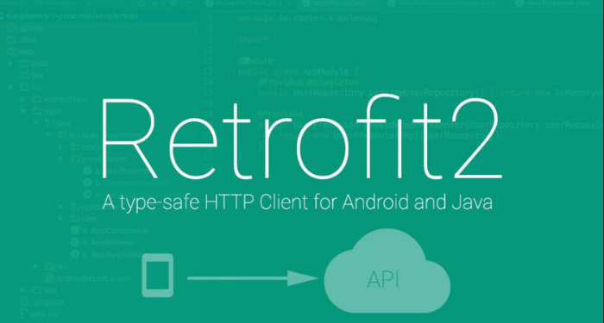



Introduction
Technology
Spring Boot rest API
ReactJS, React Hook
Android Studio
Google maps API
Google chart
Google translate API
Dieasea.sh API
News API
React QR
React report
FireBase OTP
Postman

Slide 10
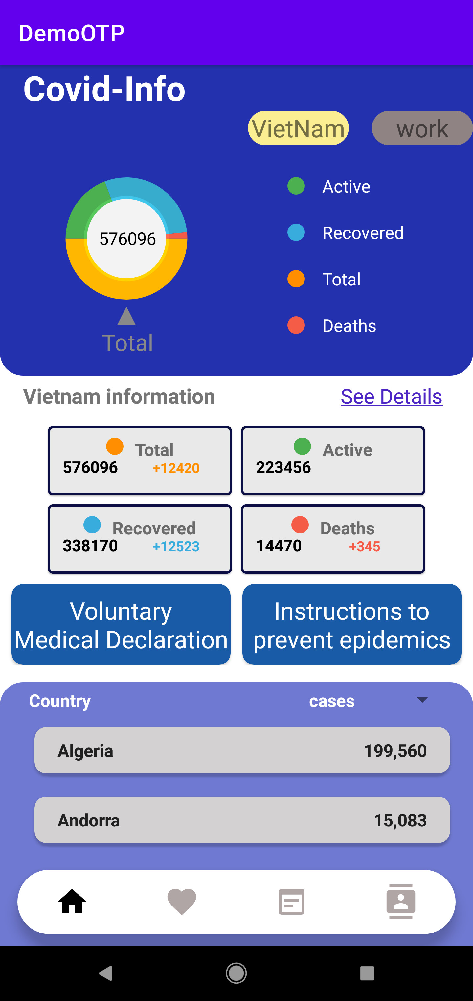
Project preview
Android main view

Slide 11
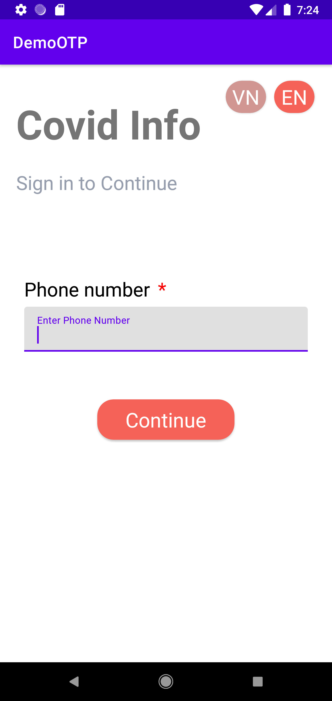
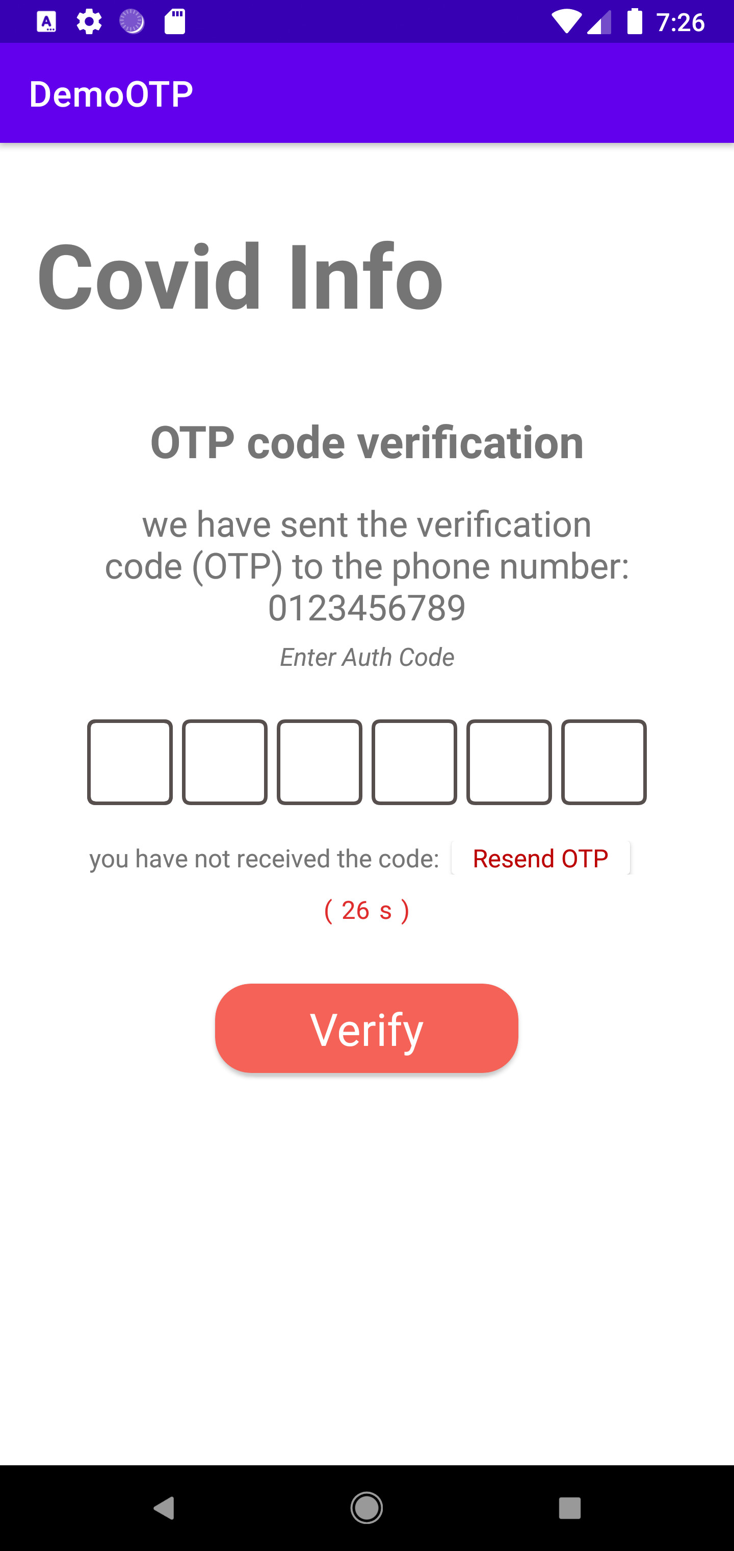
Project preview
Android Phone OTP view

Slide 12
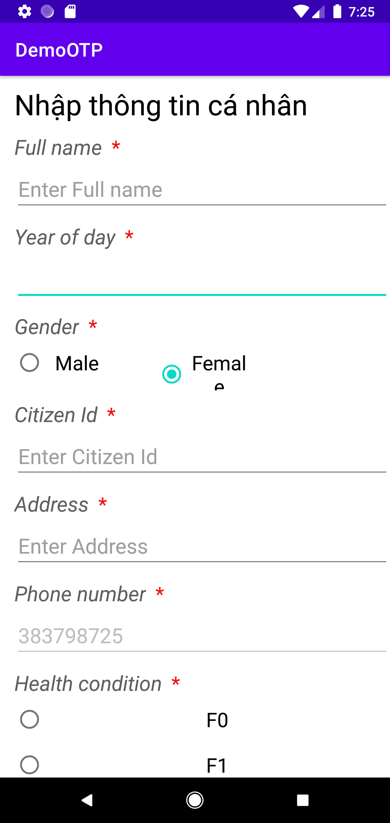
Project preview
Android User register view

Slide 13
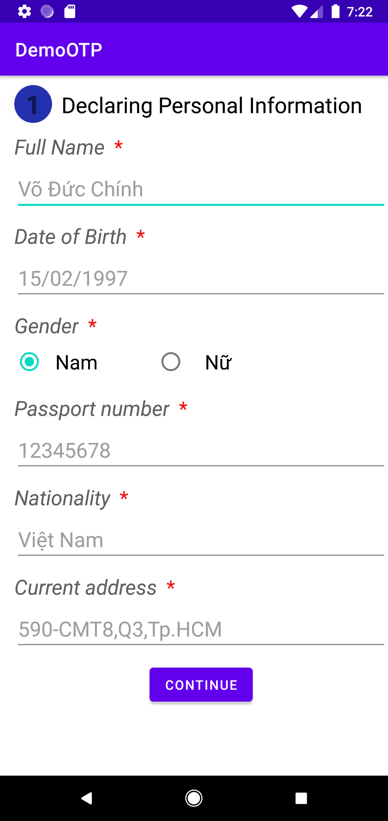
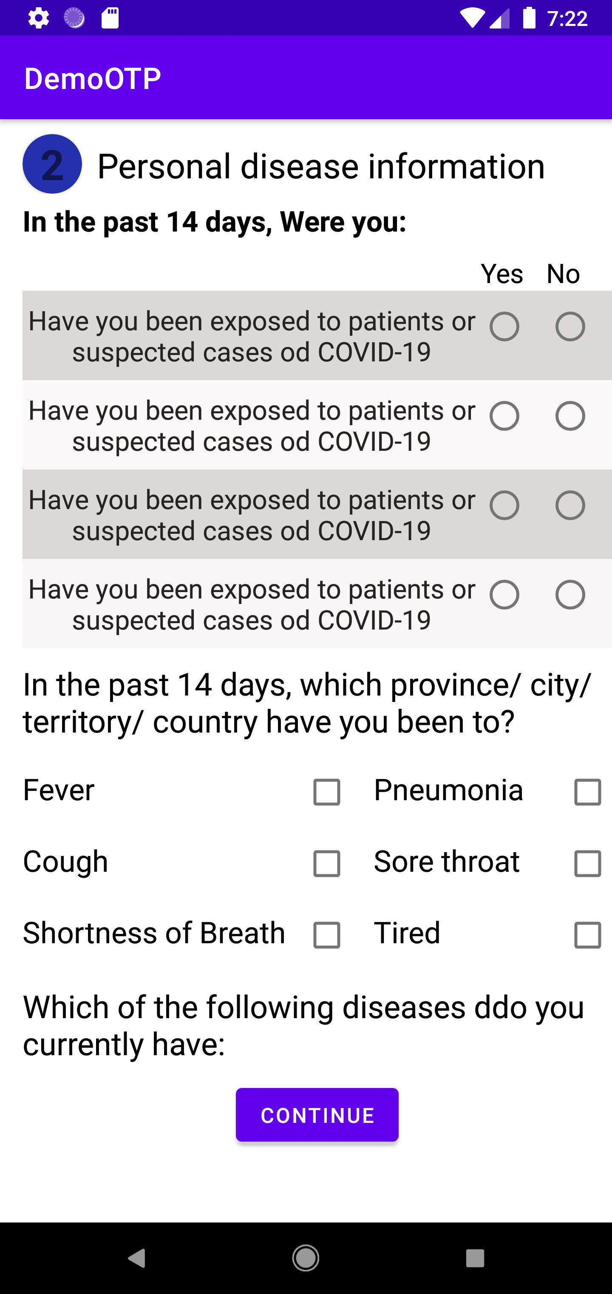
Project preview
Andoird Health declaration view

Slide 14
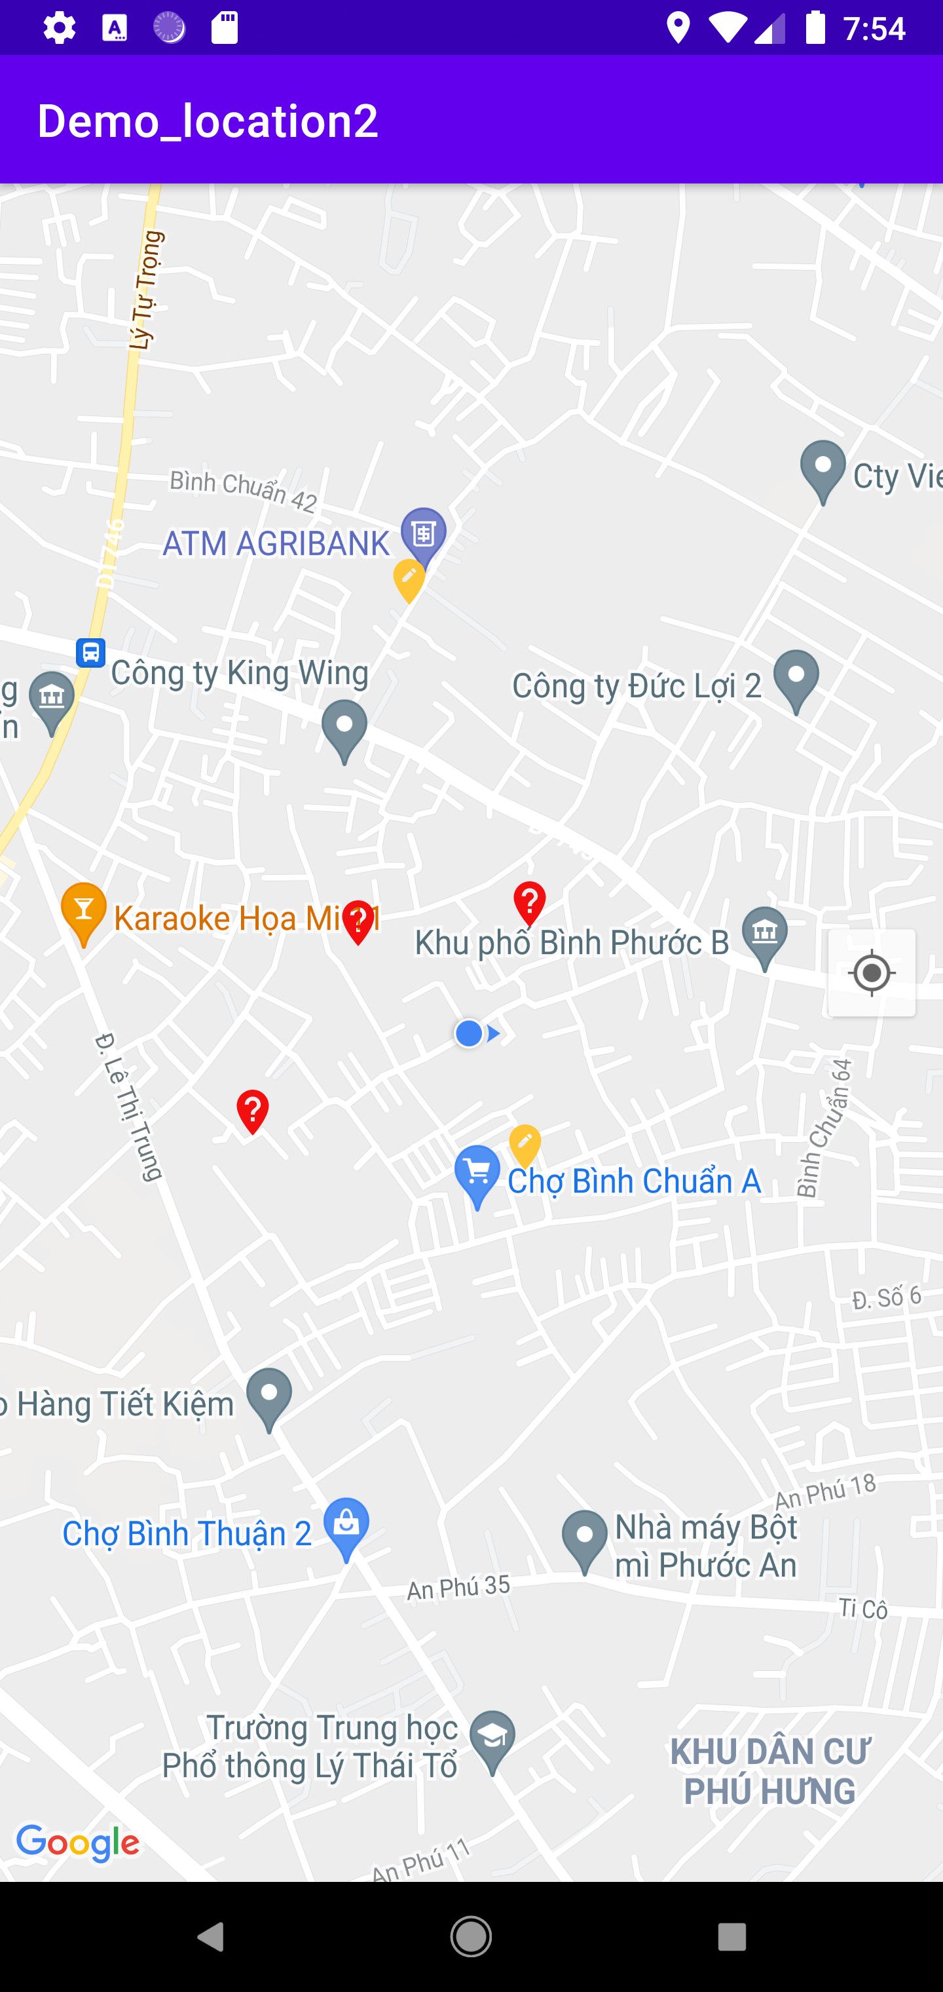
Project preview
Android infected area map view

Slide 15
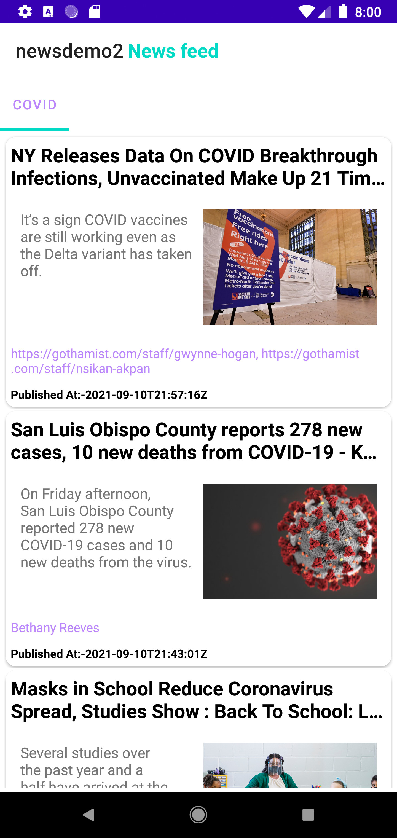
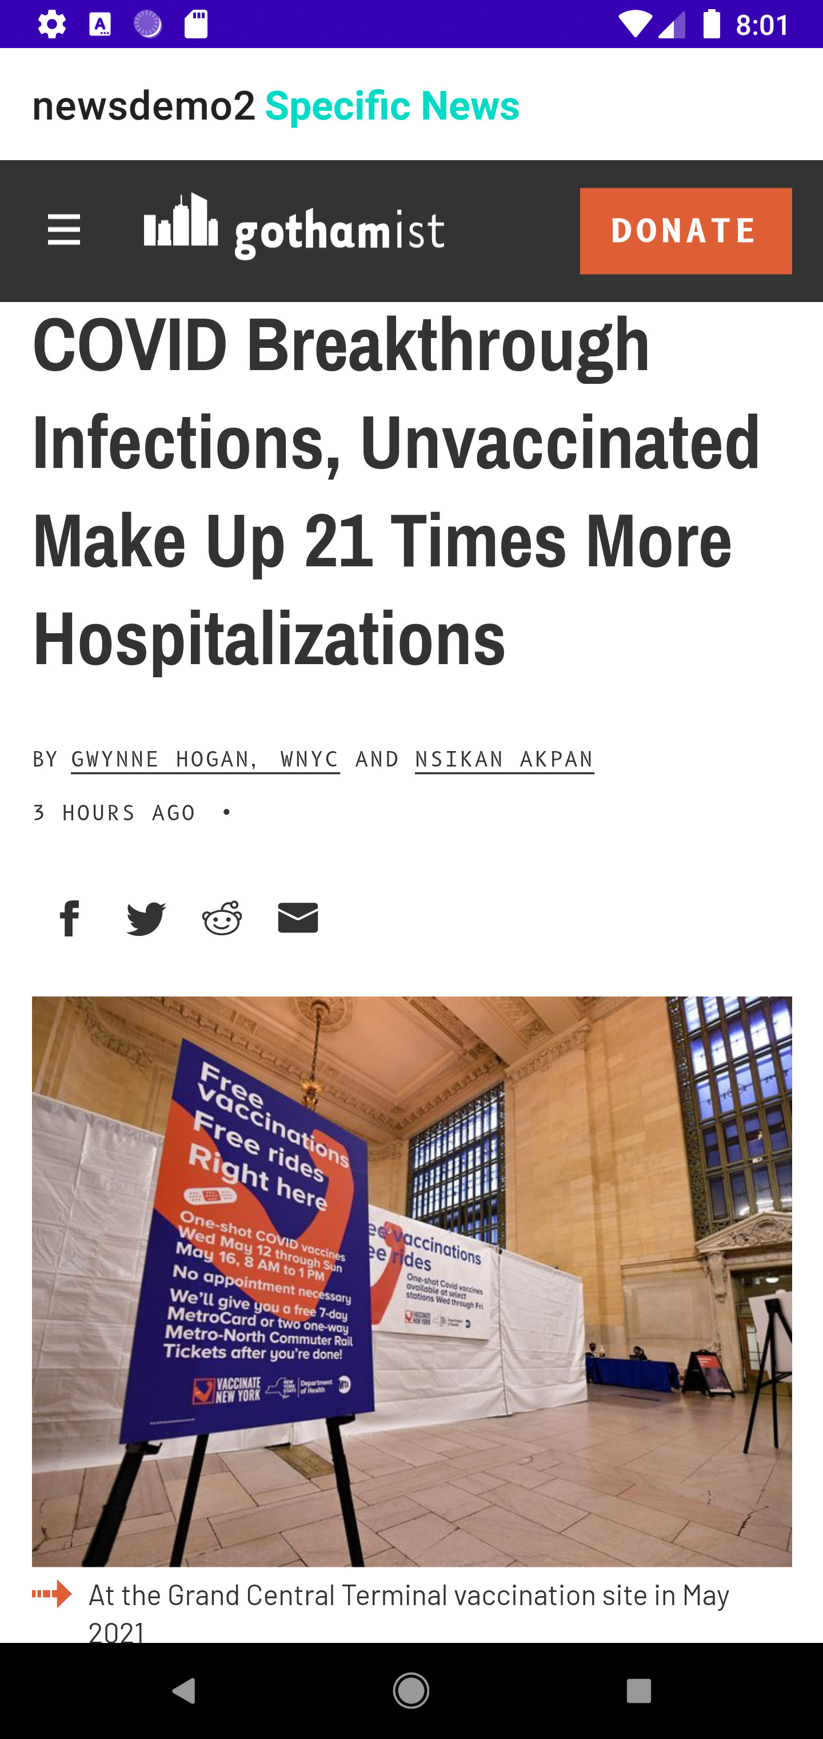
Project preview
Android Covid articles view

Slide 16
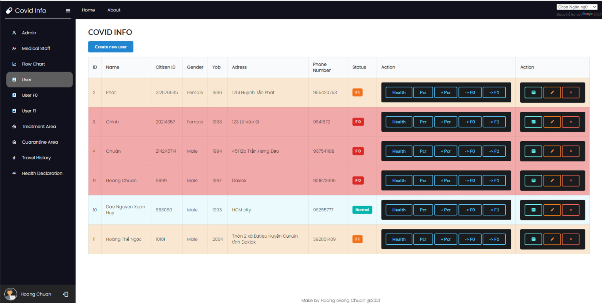
Project preview
User management page

Slide 17
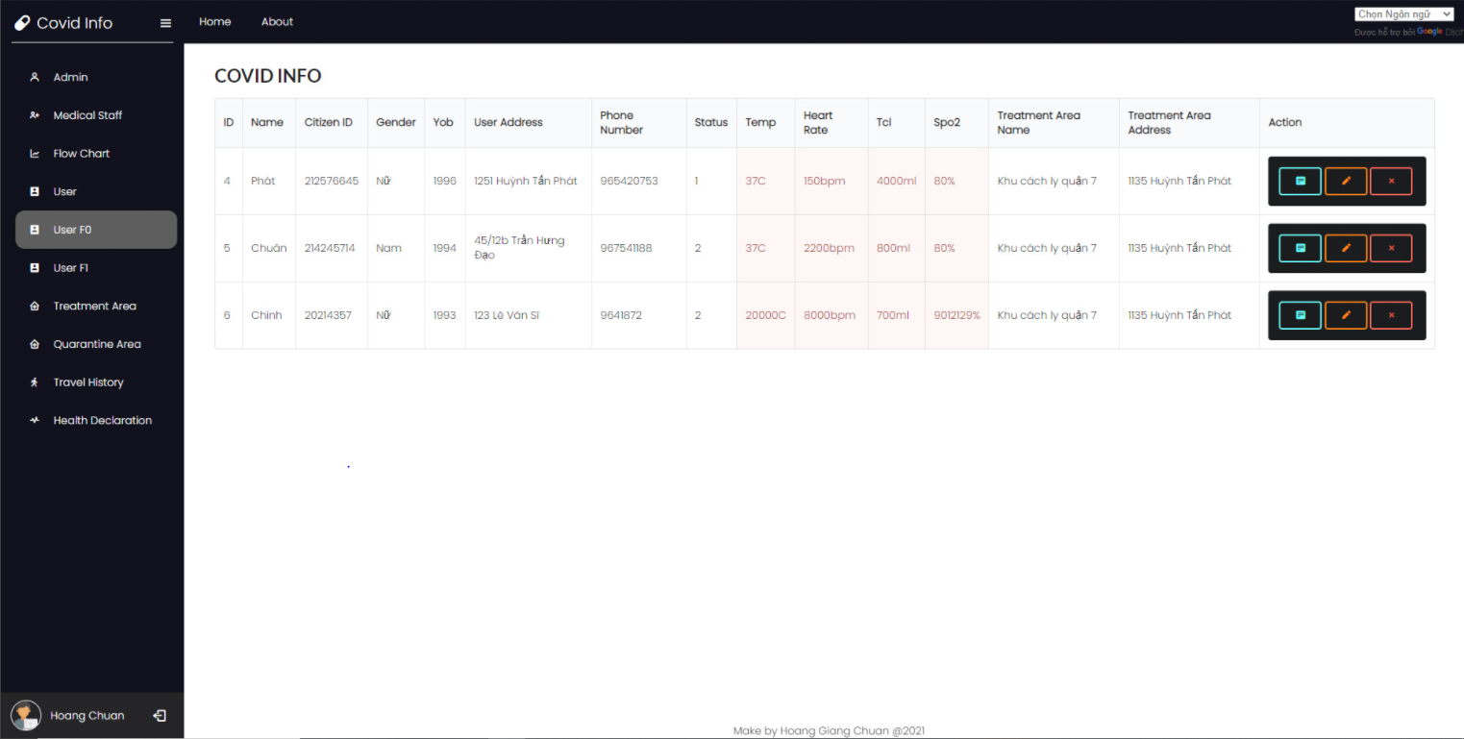
Project preview
F0 management page

Slide 18
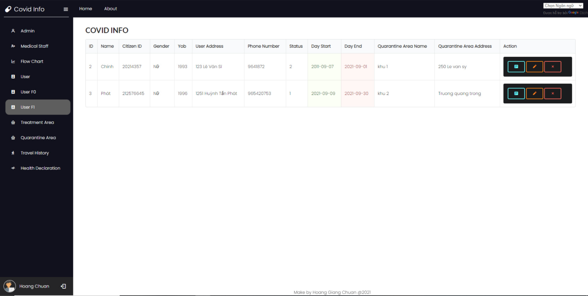
Project preview
F1 management page

Slide 19
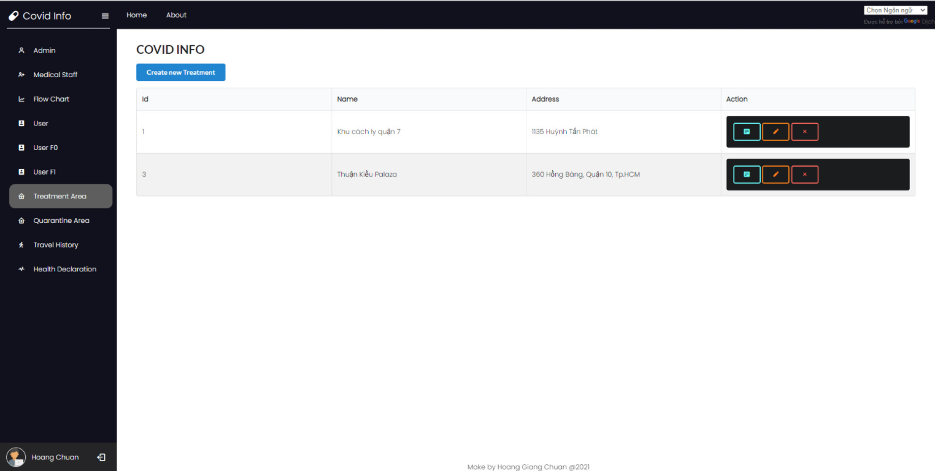
Project preview
Treatment area management page

Slide 20
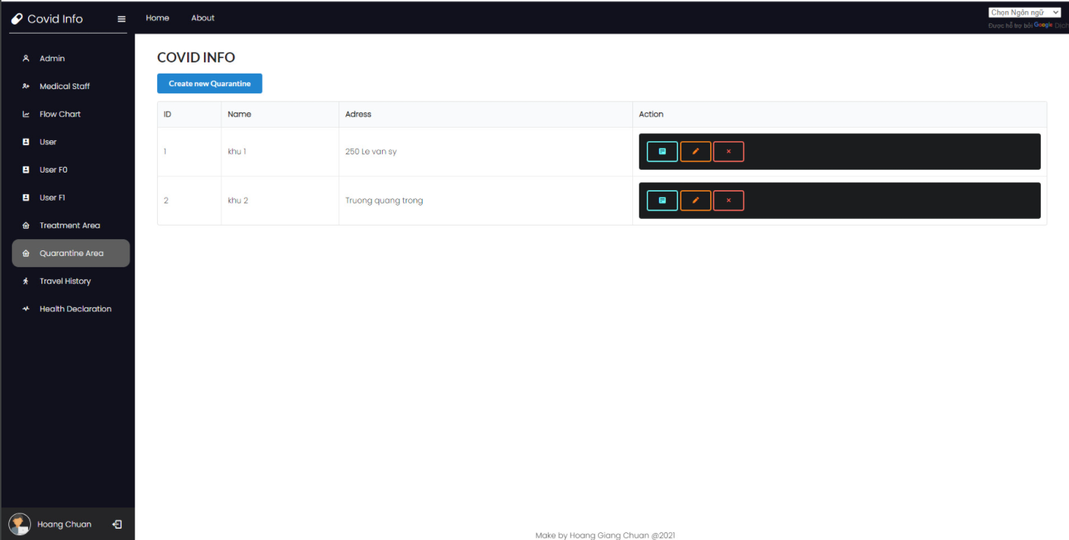
Project preview
Quarantine area management page

Slide 21

Conclusion & Discussion
With the knowledge accumulated in the process of studying and working at FPT Aptech, our team have tried our best to complete this project as best as possible.
We have also learnt about working remotely and time management due to working with the project during lockdown.

Slide 22

Conclusion & Discussion
Discussion
The evaluations of teachers and friends will be valuable guides for us in the future.

Slide 23
Task sheet
Project Ref. No.: COVID INFO |  | Project Title: | Activity Plan Prepared By: | Date of Preparation of Activity Plan:
Sr.No. | Task |  |  | Actual Start Date | Actual Days | Team Mate Names | Status
1 | Database Structure | COVID INFO | Nguyen Nhuan Phat | 28/08/2021 | 1 | Nguyen Nhuan Phat | 100%
2 | Documentation |  |  | 28/08/2021 | 1 |  | 100%
3 | User f1 |  |  | 28/08/2021 | 2 |  | 100%
4 | Android Covid news article |  |  | 28/08/2021 | 3 |  | 100%
5 | PCR test |  |  | 28/08/2021 | 1 |  | 100%
6 | Travel History admin |  |  | 28/08/2021 | 2 |  | 100%
7 | Health declaration admin |  |  | 28/08/2021 | 1 |  | 100%

Slide 24
Task sheet
Project Ref. No.: COVID INFO |  | Project Title: | Activity Plan Prepared By: | Date of Preparation of Activity Plan:
Sr.No. | Task |  |  | Actual Start Date | Actual Days | Team Mate Names | Status
8 | Admin dashboard | COVID INFO | Nguyen Nhuan Phat | 28/08/2021 | 6 | Hoang Giang Chuan | 100%
9 | User admin |  |  | 28/08/2021 | 1 |  | 100%
10 | User f0 |  |  | 28/08/2021 | 2 |  | 100%
11 | QR |  |  | 28/08/2021 | 1 |  | 100%
12 | Chart |  |  | 28/08/2021 | 1 |  | 100%
13 | Report |  |  | 28/08/2021 | 3 |  | 100%
14 | Admin covid statistic |  |  | 28/08/2021 | 1 |  | 100%
15 | Medical Staff |  |  | 28/08/2021 | 1 |  | 100%

Slide 25
Task sheet
Project Ref. No.: COVID INFO |  | Project Title: | Activity Plan Prepared By: | Date of Preparation of Activity Plan:
Sr.No. | Task |  |  | Actual Start Date | Actual Days | Team Mate Names | Status
17 | User android | COVID INFO | Nguyen Nhuan Phat | 28/08/2021 | 3 | Vo Duc Chinh | 100%
18 | Health declaration android |  |  | 28/08/2021 | 2 |  | 100%
19 | Health daily android |  |  | 28/08/2021 | 1 |  | 100%
20 | Travel history android |  |  | 28/08/2021 | 1 |  | 100%
21 | Android user Covid statistic |  |  | 28/08/2021 | 3 |  | 100%
22 | Firebase OTP |  |  | 28/08/2021 | 1 |  | 100%
23 | User registering process |  |  | 28/08/2021 | 1 |  | 100%
24 | Quarantine area/Treatment area Map for Android |  |  | 28/08/2021 | 2 |  | 100%
25 | Vaccination Passport |  |  | 28/08/2021 | 2 |  | 100%

Slide 26
Task sheet
Project Ref. No.: COVID INFO |  | Project Title: | Activity Plan Prepared By: | Date of Preparation of Activity Plan:
Sr.No. | Task |  |  | Actual Start Date | Actual Days | Team Mate Names | Status
25 | Login/Logout | COVID INFO | Nguyen Nhuan Phat | 28/08/2021 | 1 | Dao Nguyen Xuan Huy | 100%
26 | Admin |  |  | 28/08/2021 | 1 |  | 100%
27 | Session |  |  | 28/08/2021 | 2 |  | 100%
28 | Quarantine area |  |  | 28/08/2021 | 2 |  | 100%
29 | Treatment area |  |  | 28/08/2021 | 2 |  | 100%
30 | User f1/f0 Maps |  |  | 28/08/2021 | 2 |  | 100%
31 | Health daily admin |  |  | 28/08/2021 | 1 |  | 100%
32 | Admin vaccination |  |  | 28/08/2021 | 1 |  | 100%

Slide 27
The end
Thank you
For your attention

